Slide 1


The Virtual Classroom
This presentation will explore the evaluation of our HTML and CSS project. We'll delve into its objectives, features, design layout, benefits, and conclude with key takeaways.
Maarij Ahmed (24k-0550) Group Leader
Burair Hyder (24k-0804)
Mutahir Ahmed (24k-0030
7

Slide 2

Introduction
Project Overview
Project Goals
Our project aimed to develop a dynamic and user-friendly website using HTML and CSS.
Our primary goals included creating a visually appealing site with seamless navigation, user-friendly interface, and optimal performance.
2
2

Slide 3

Objectives
1
Simplify access to educational resources.
2
Provide a structured and user-friendly interface.
3
Promote self-paced learning.
4
Enhance student-teacher communication.
3

Slide 4

Features
Home Page
Course Materials Page
Assignments Page
Overview of the website.
Organized display of lecture notes and resources.
Form for assignment uploads.
Dashboard
Contact Page
Static representation of student progress.
Displays teacher contact information, for easy access and communication.
4
4

Slide 5




Login Page
Responsive Design
Ease of Use
User Authentication
Adapts seamlessly to desktop and mobile screens.
Features placeholders, labels, and a prominent "Login" button.
Static fields for Username/Email and Password, ready for future backend integration.
5
5

Slide 6




Home Page
Introduction
Navigation
Visual Appeal
Welcomes users with an overview of the platform's purpose and features.
Provides easy access to key sections like Courses, Assignments, and Dashboard.
Features a clean layout with engaging headings, images, and a consistent color scheme.
6

Slide 7




Course Materials Page
Content Organization
Easy Navigation
Download Options
Displays lecture notes, slides, and resources in a structured format.
Sections for each course topic, allowing users to quickly find relevant materials.
Links to downloadable files, such as PDFs and presentations, for offline access.
7

Slide 8







Assignments Page
Submission Form
Clear Instructions
Visual Cues
Simple form allowing users to upload assignments.
Provides guidelines for each assignment with submission deadlines.
Use of icons or progress bars to show the upload status.
8

Slide 9



Dashboard
Progress Overview
Upcoming Deadlines
Personalized Data
Displays visual progress charts showing student performance.
Lists upcoming assignments and due dates for quick reference.
Displays static data such as grades or course completion status.
9

Slide 10



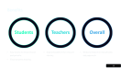

Contact Page
Teacher Information
Organized Layout
Responsive Design
Displays contact details for multiple teachers, allowing easy access for students.
Each teacher's contact details are neatly organized in separate cards for clarity.
The page adjusts for different screen sizes, ensuring that contact details are accessible on both mobile and desktop devices.
10

Slide 11



Benefits
Students
Teachers
Overall
Easy access to resources and assignments.
Organized platform for resource sharing.
Reduces reliance on manual tasks and paperwork.
Visual progress tracking.
11

Slide 12

12

Slide 13
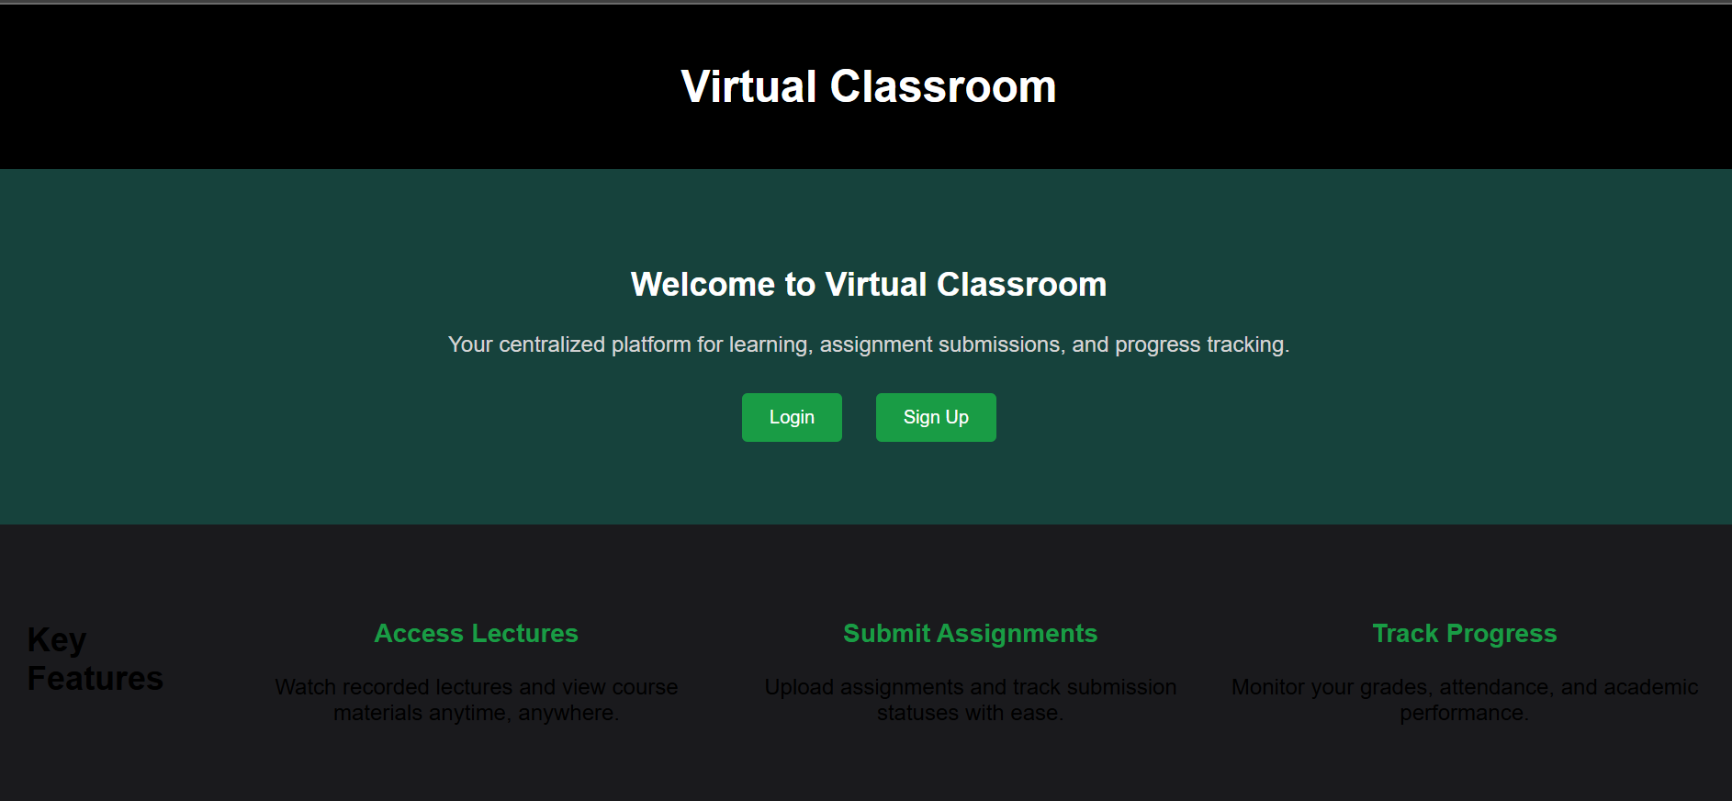

Slide 14


Slide 15
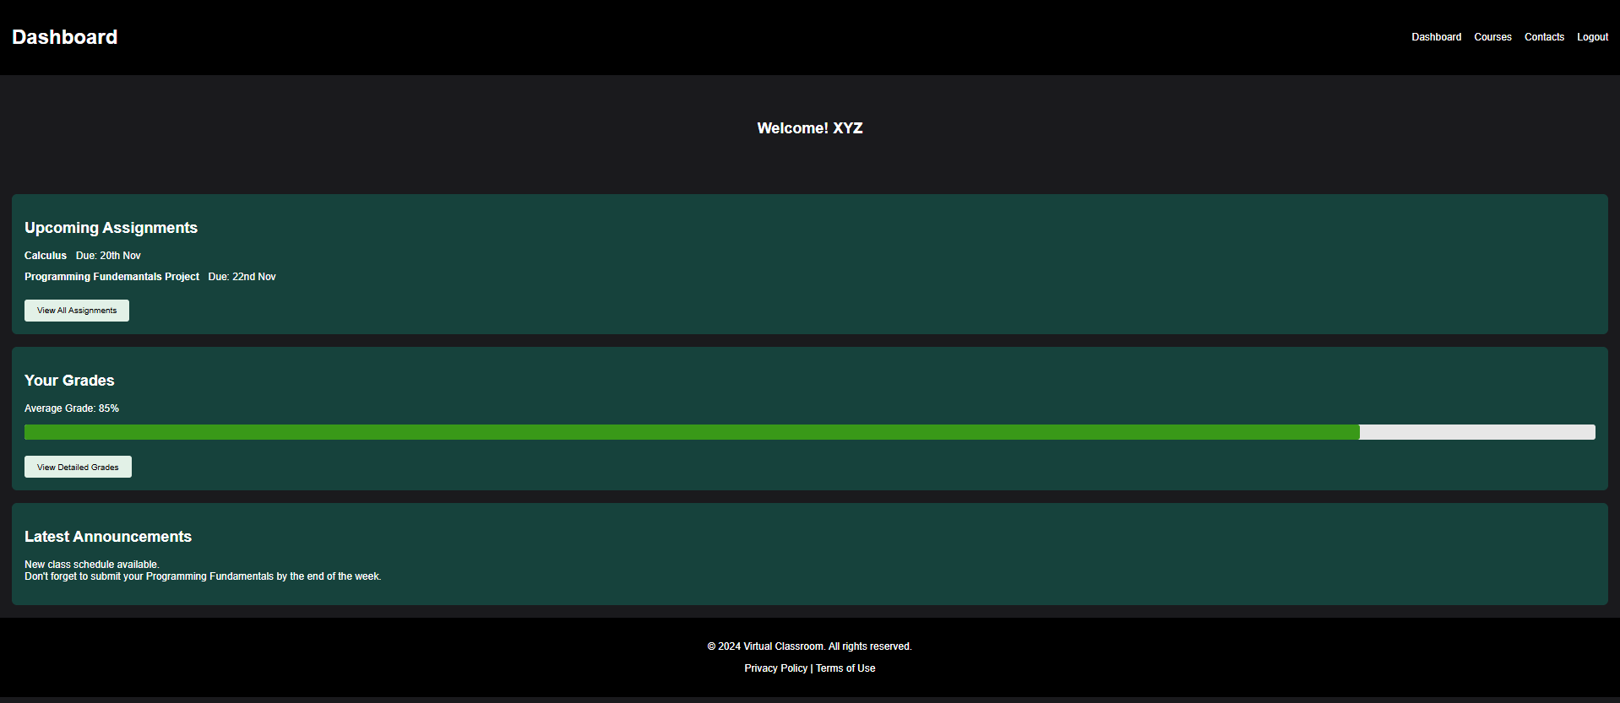

Slide 16
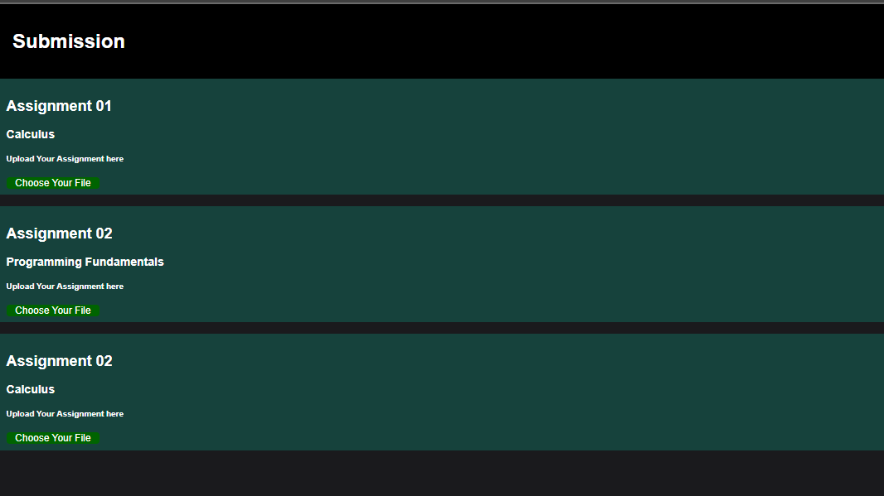

Slide 17
